Slide 1

Chapter 4
Digital
Transmission
School of Computer Science and Engineering
Pusan National University
Jeong Goo Kim

Slide 2
Ch. 4 Outline
    Outline
4.1 Digital-to-Digital Conversion
4.2 Analog-to-digital
4.3 Transmission Modes

Slide 3
    Ch. 4 Objective
    Objective
Digital-to-digital conversion.
  Line coding
  block coding (redundancy)
  scrambling
Analog-to-digital conversion
  Pulse code modulation
  Delta modulation
Transmission modes
  serial transmission
  parallel transmission

Slide 4
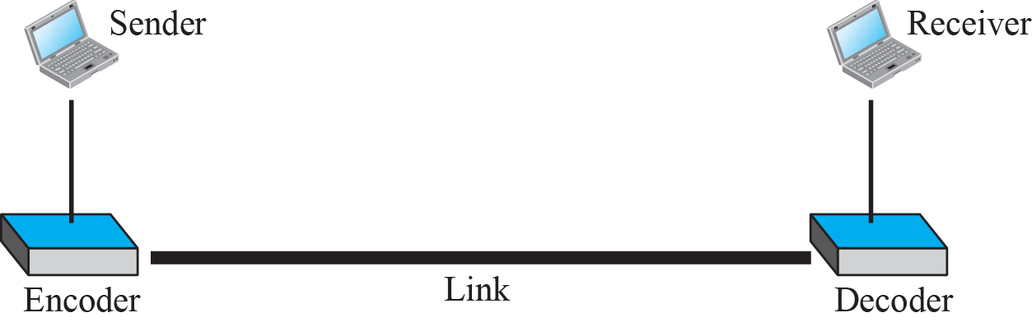
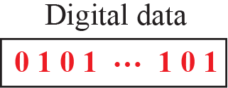
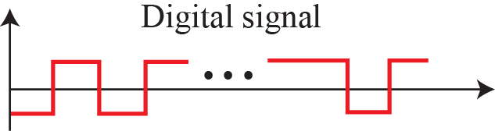
    4.1 Digital-to-Digital Conversion
    4.1 Digital-to-Digital Conversion
    4.1.1 Line Coding
is the process of converting digital data to digital signals
Fig. 4.1 Line coding and decoding

Slide 5
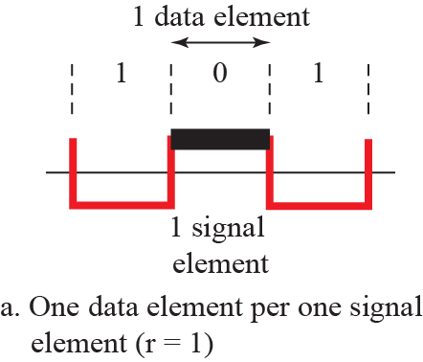
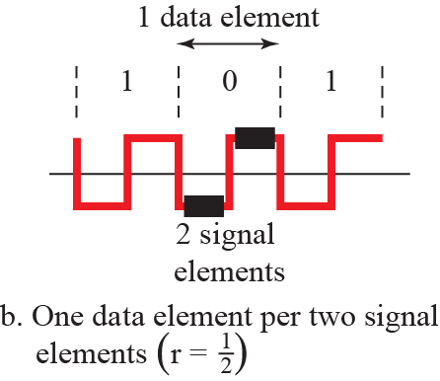
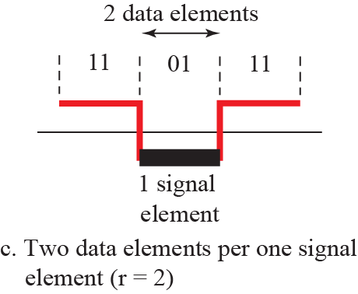
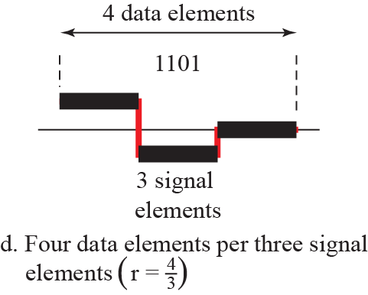
    4.1 Digital-to-Digital Conversion
    Characteristics
Signal element vs. Data element
Fig. 4.2 Signal elements versus data elements

Slide 6

    4.1 Digital-to-Digital Conversion
Data rate vs. Signal rate
  Data rate : bit rate
  Signal rate : pulse rate, modulation rate, or baud rate
Here N is data rate and r is the number of data elements carried by
each signal element
  Average signal rate S_{avg} = c × N × (1/r) baud, here c is the case factor
Ex. 4.1
$$Signal rate(S)= \frac{N}{r}$$

Slide 7

    4.1 Digital-to-Digital Conversion
Bandwidth
  effective bandwidth is finite
  minimum bandwidth B_{min} = c × N × (1/r)
  maximum data rate N_{max} = (1/c) × B × r
Ex. 4.2
Baseline Wandering
DC component
Self-synchronization
Built in error detection
Immunity to Noise and Interference
Complexity

Slide 8
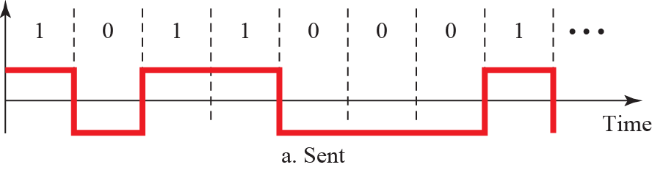
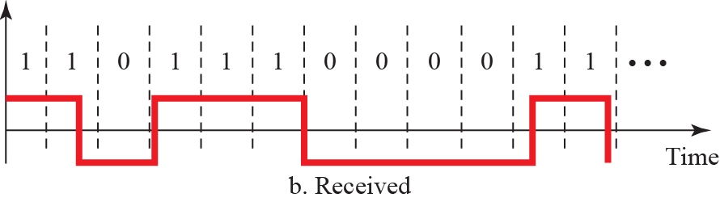
    4.1 Digital-to-Digital Conversion
Ex. 4.2
Fig. 4.3 Effect of lack of synchronization

Slide 9
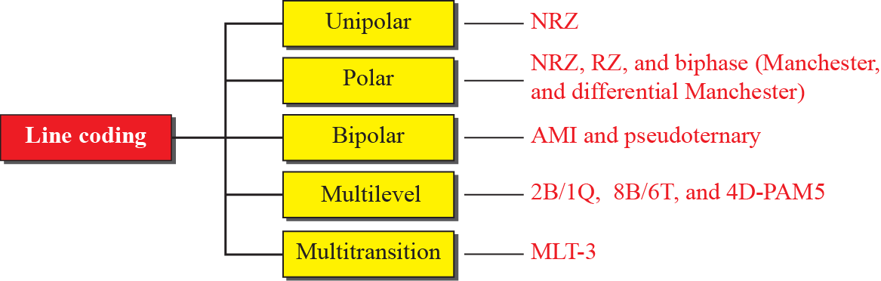
    4.1 Digital-to-Digital Conversion
    4.1.2 Line Coding Schemes
Fig. 4.4 Line coding scheme

Slide 10
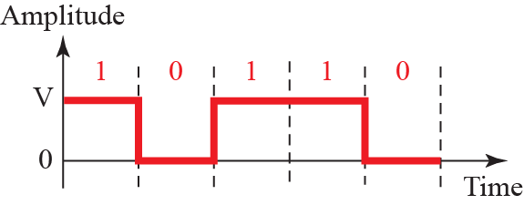
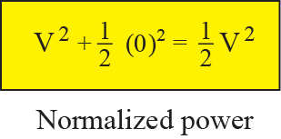
    4.1 Digital-to-Digital Conversion
    Unipolar Schemes
All the signal levels are on one side of the time axis
NRZ(Non-Return-to-Zero)
Fig. 4.5 Unipolar NRZ scheme

Slide 11
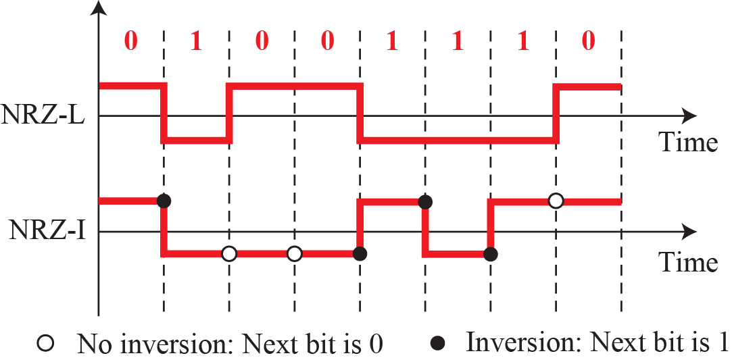
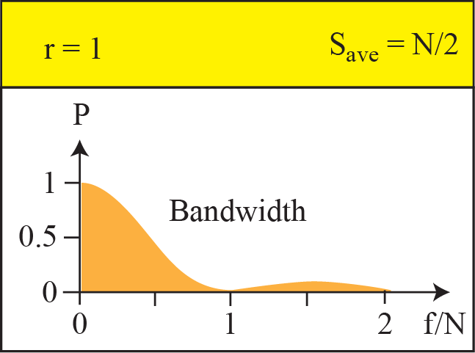
    4.1 Digital-to-Digital Conversion
    Polar Schemes
All the signal levels are on both side of the time axis
NRZ-L(NRZ-Level), NRZ-I(NRZ-Inversion)
  average signal rate is N/2 Bd.
  DC component and self-synchronization problem
Fig. 4.6 Polar NRZ-L and NRZ-I
Ex. 4.4 S_{avg}=N/2=500 kbaud, B_{min}= S = 500 kHz

Slide 12
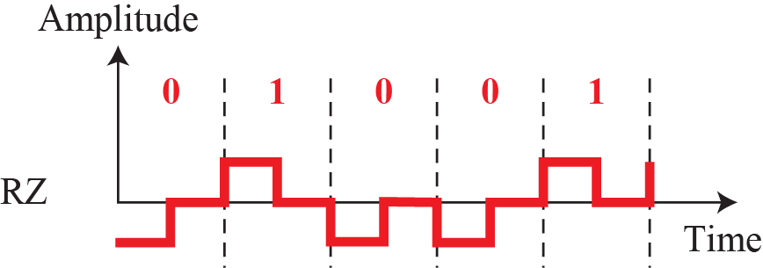
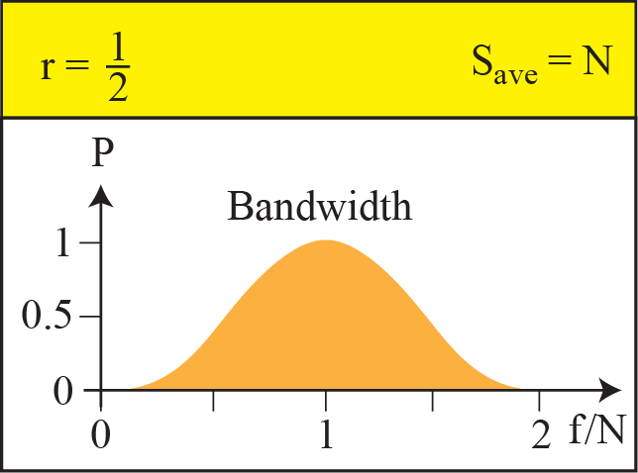
    4.1 Digital-to-Digital Conversion
    Polar Schemes
RZ(Return-to-Zero)
  Self-synchronization
  Large bandwidth
Fig. 4.7 Polar RZ

Slide 13
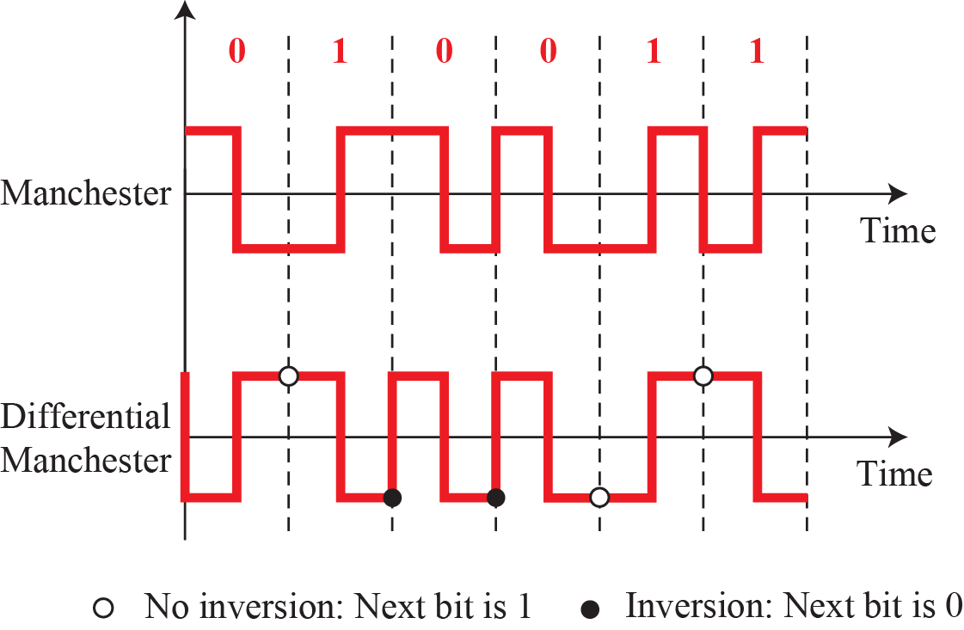
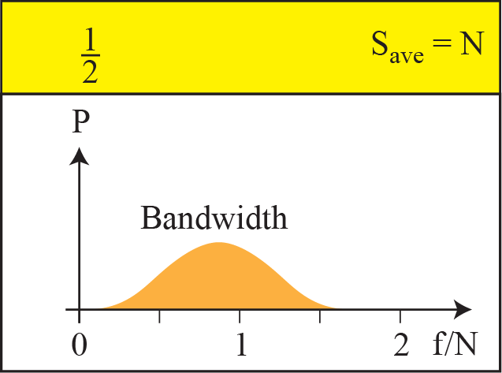
    4.1 Digital-to-Digital Conversion
    Polar Schemes
Biphase: Manchester and Differential Manchester
  Self-synchronization
  No DC component
  Large bandwidth
Fig. 4.8 Polar Biphase: Manchester and Differential Manchester

Slide 14
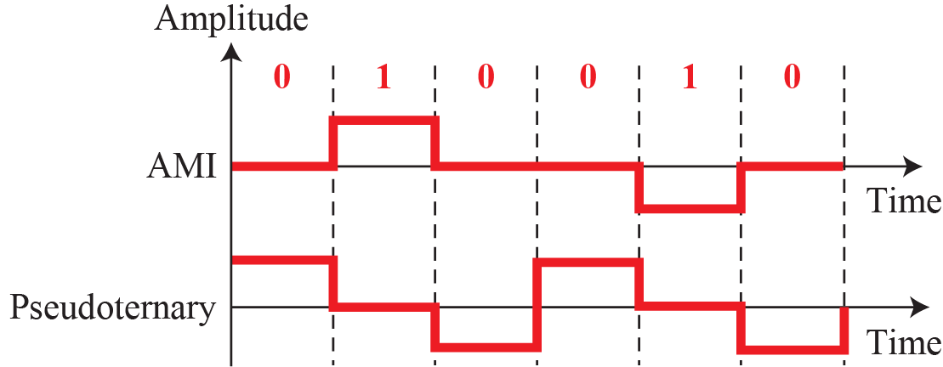
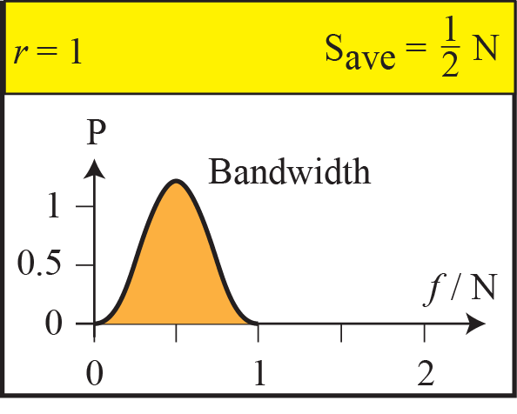
    4.1 Digital-to-Digital Conversion
    Bipolar Schemes
Use three levels, positive, zero, and negative
Alternate Mark Inversion(AMI), pseudoternary
  No DC component
    Fig. 4.9 Bipolar Schemes: AMI, pseudoternary

Slide 15
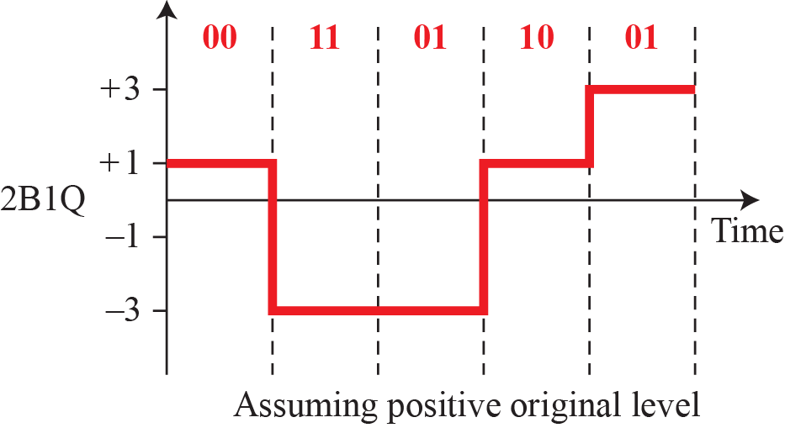
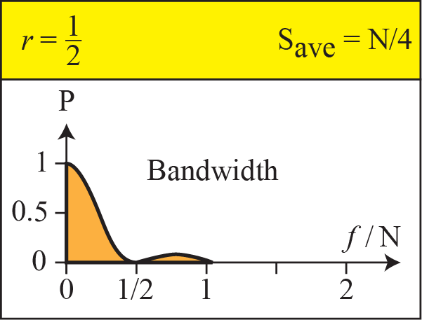
    4.1 Digital-to-Digital Conversion
    Multilevel Schemes
mBnL: m-bit n-level
2B1Q(2-bit 1-quaternary)
    Fig. 4.10 Multilevel: 2B1Q

Slide 16
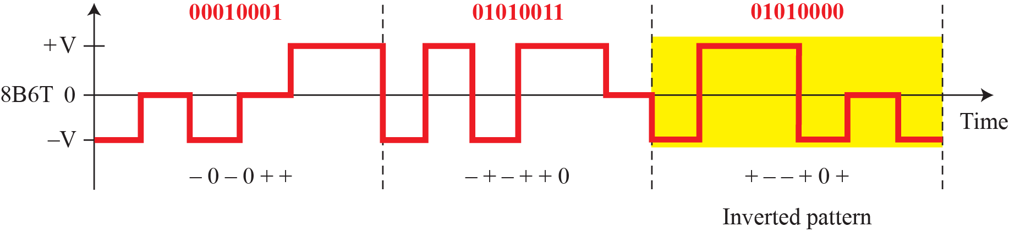
    4.1 Digital-to-Digital Conversion
    Multilevel Schemes
8B6T(8-bit 6-ternary)
  100BASE-4T
  2⁸(256) < 3⁶(729)
    Fig. 4.11 Multilevel: 8B6T

Slide 17
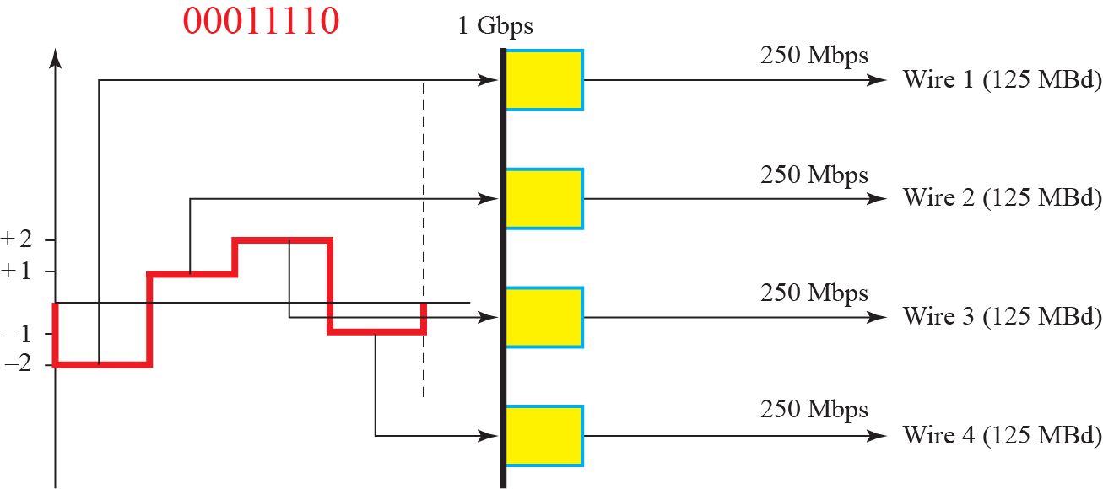
    4.1 Digital-to-Digital Conversion
    Multilevel Schemes
4D-PAM5(4-dimensional 5-level pulse amplitude modulation)
    Fig. 4.12 Multilevel: 4D-PAM5

Slide 18
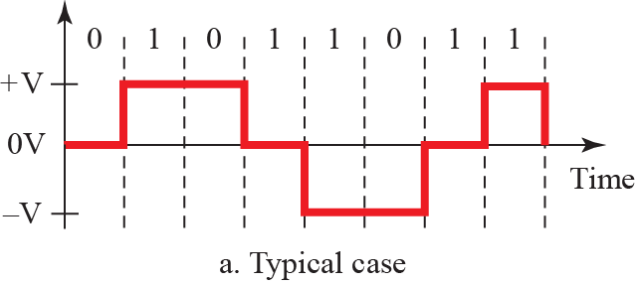
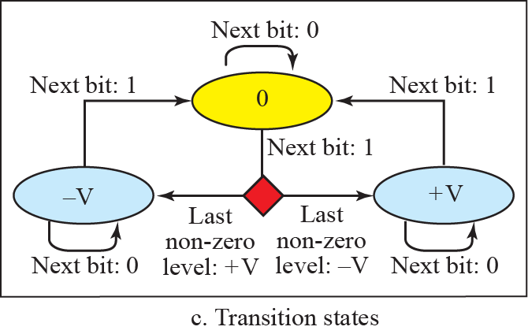
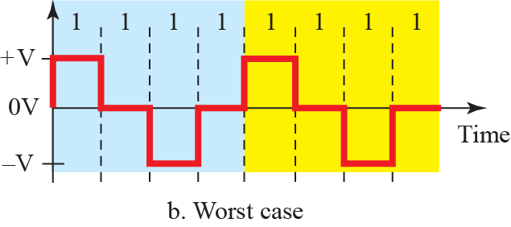
    4.1 Digital-to-Digital Conversion
    Multitransition: MLT3
    Fig. 4.13 Multitransition: MLT3

Slide 19
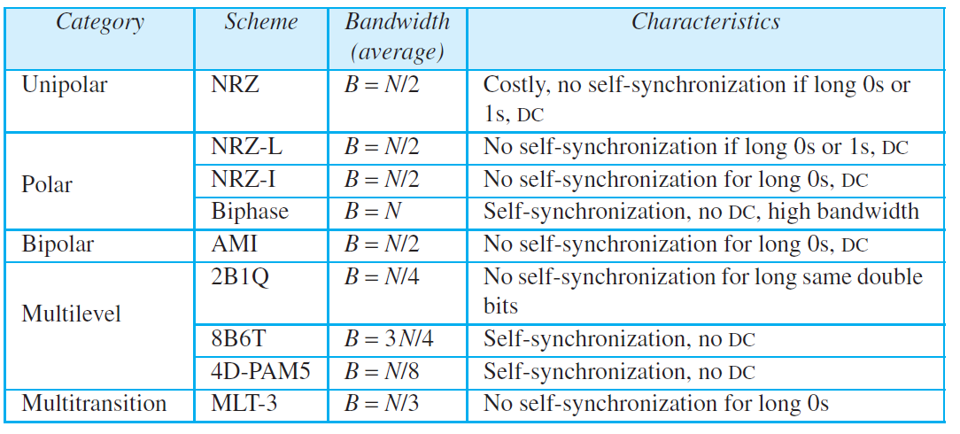
    4.1 Digital-to-Digital Conversion
    Summary of Line Coding Schemes
    Table 4.1 Summary of Line Coding Schemes

Slide 20
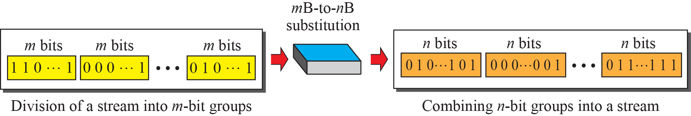
    4.1 Digital-to-Digital Conversion
    4.1.3 Block Coding
  mB/nB - (n-m) redundancy
  to ensure synchronization
  for error control
Fig. 4.14 Block coding concept

Slide 21
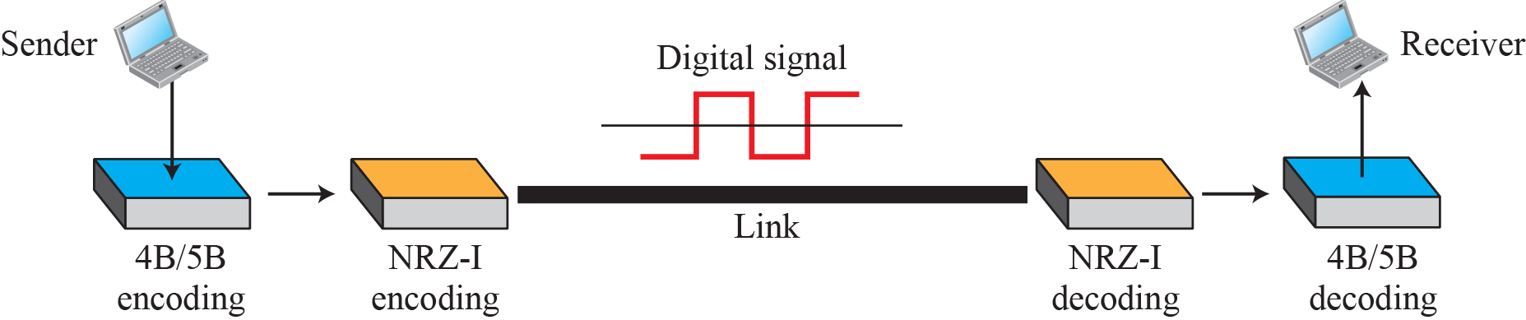
    4.1 Digital-to-Digital Conversion
    4B/5B
  NRZ-I + synchronization
Fig. 4.15 Using block coding 4B/5B with NRZ-I line coding scheme

Slide 22
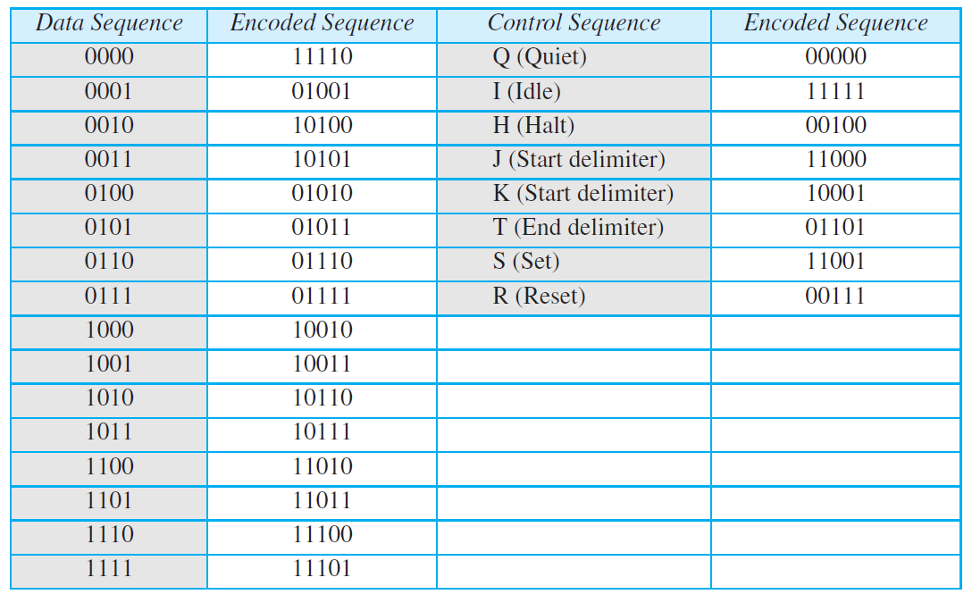
    4.1 Digital-to-Digital Conversion
    Table 4.2 4B/5B mapping codes

Slide 23
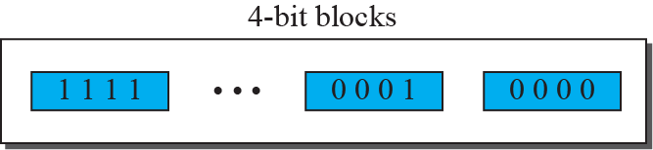
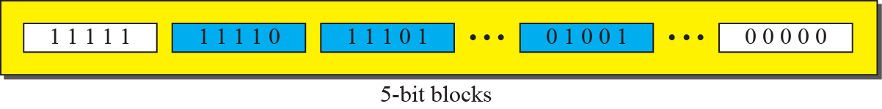
    4.1 Digital-to-Digital Conversion
Fig. 4.15 Substitution in 4B/5B block coding
Ex. 4.5

Slide 24
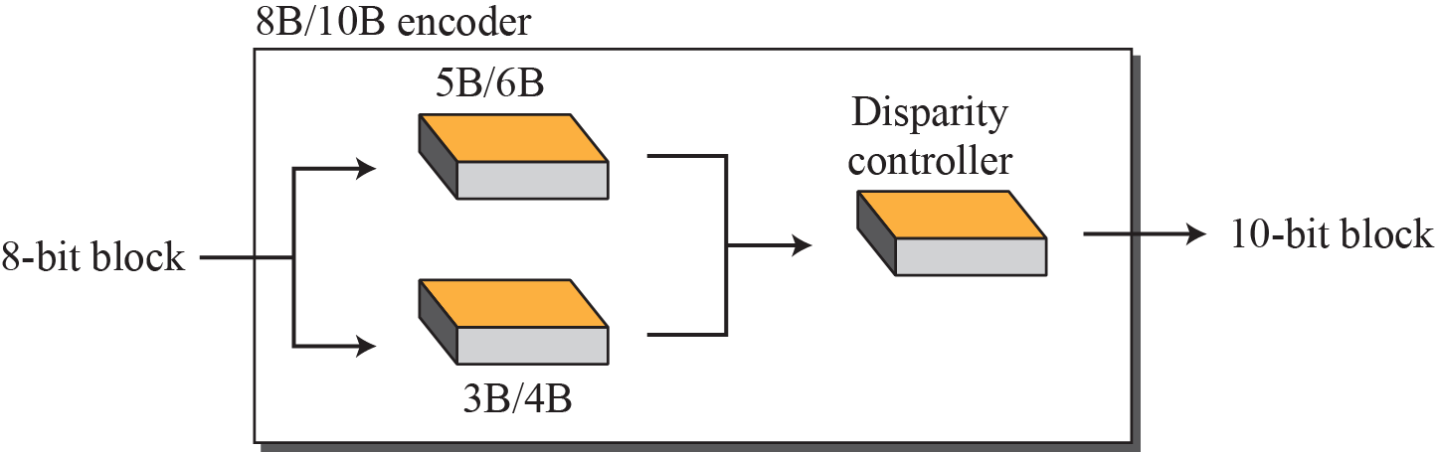
    4.1 Digital-to-Digital Conversion
    8B/10B
  5B/6B + 3B/4B
Fig. 4.17 8B/10B block encoding

Slide 25
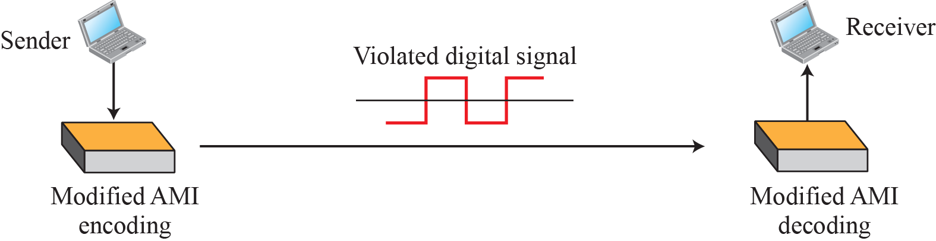
    4.1 Digital-to-Digital Conversion
    4.1.4 Scrambling
Substitutes long zero-level pulses with a combination of other levels to provide synchronization
Fig. 4.18 AMI used with scrambling

Slide 26
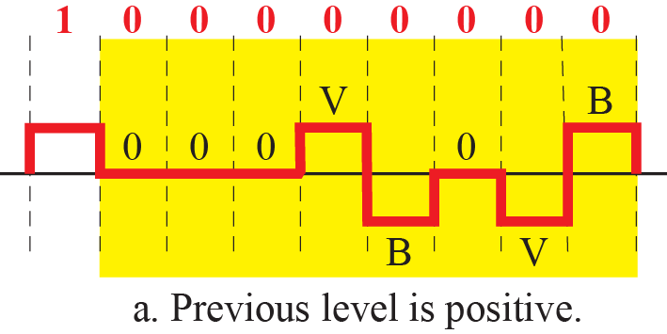
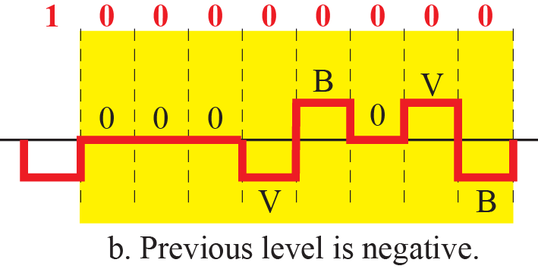
    4.1 Digital-to-Digital Conversion
B8ZS(Bipolar with 8 zero substitution)
Fig. 4.19 Two cases of B8ZS scrambling technique

Slide 27
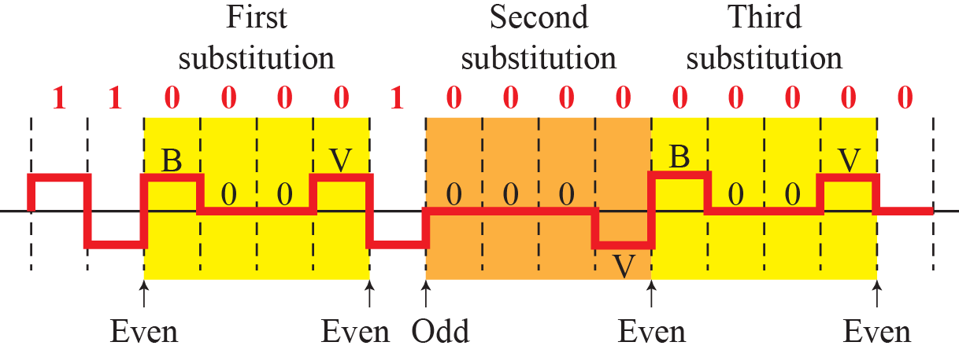
    4.1 Digital-to-Digital Conversion
HDB3(High-density bipolar 3-zero)
Fig. 4.20 Different situations in HDB3 scrambling technique

Slide 28
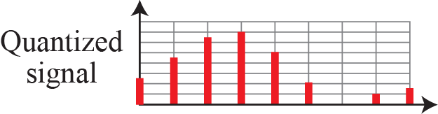
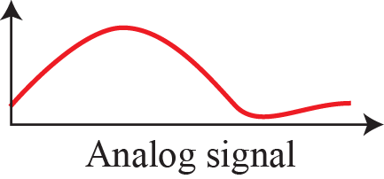
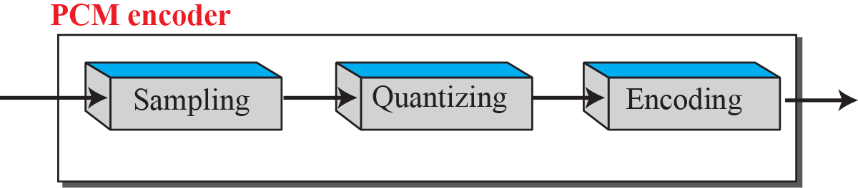
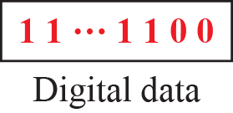
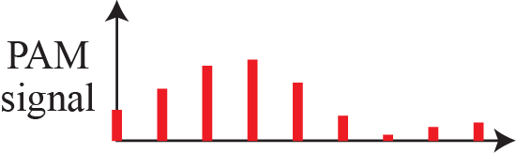
    4.2 Analog-to-Digital Conversion
    4.2 Analog-to-Digital Conversion
    4.2.1 Pulse Code Modulation (PCM)
The most common technique to change an analog signal to digital data (digitization)
Fig. 4.21 Components of PCM encoder

Slide 29
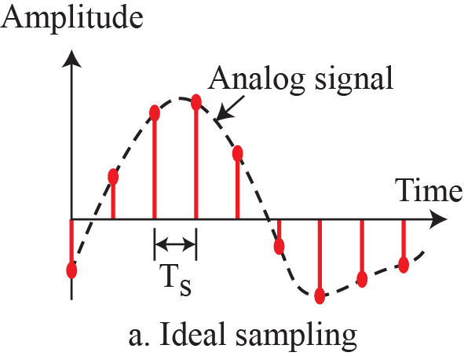
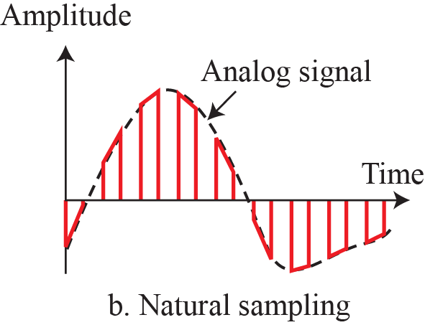
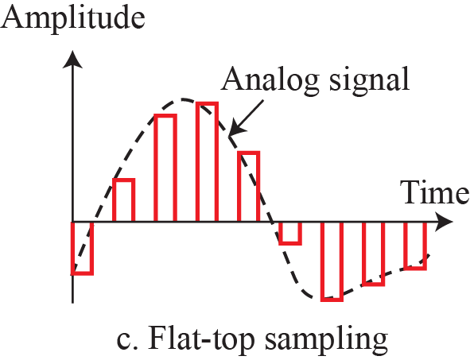
    4.2 Analog-to-Digital Conversion
    Sampling
  Ideal Sampling
  Natural Sampling
  Flat-top Sampling (sample and hold)
Fig. 4.22 Three different sampling methods for PCM

Slide 30
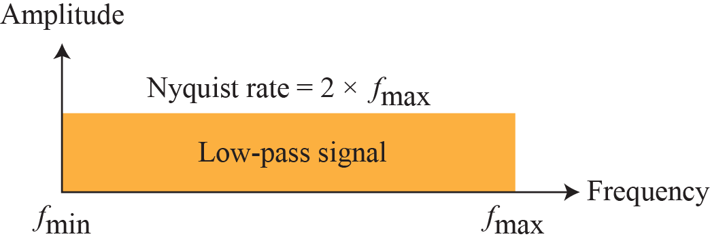
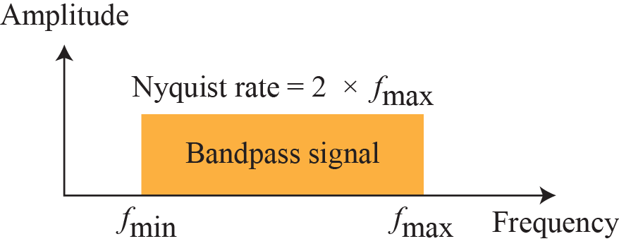
    4.2 Analog-to-Digital Conversion
    Sampling rate
  Nyquist theorem : the sampling rate must be at least 2 times the highest frequency contained in the signal
Ex. 4.6
Ex. 4.7
Fig. 4.23 Nyquist sampling rate for low-pass and bandpass signals

Slide 31
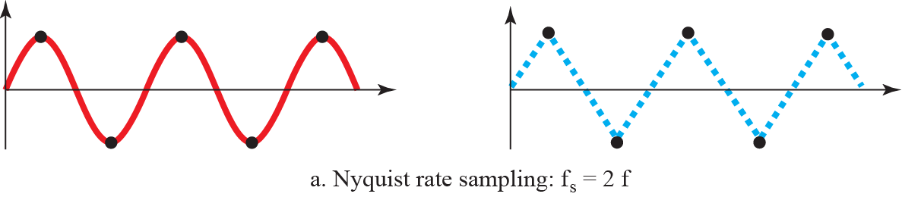
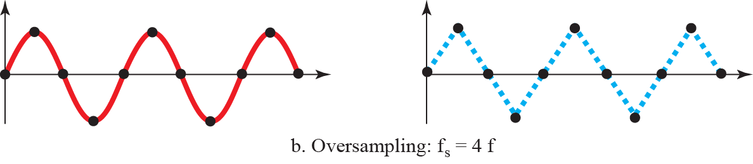

    4.2 Analog-to-Digital Conversion
Fig. 4.24 Recovery of a sine wave with different sampling rates.

Slide 32



    4.2 Analog-to-Digital Conversion
Fig. 4.25 Sampling of clock with only one hand.

Slide 33

    4.2 Analog-to-Digital Conversion
    Quantization
  The process of converting a discrete-time continuous-amplitude signal into a digital signal by expressing each sample value as a finite number of digits, is called quantization
Fig. 4.26 Quantization and encoding of a sampled signal

Slide 34
    4.2 Analog-to-Digital Conversion
Quantization error
  The error introduced in presenting the continuous-valued signal by a finite set of discrete value level is called quantization error or noise
  Quantization Levels L=2^{n} (n-bit quantization)
  Step size Δ=(V_{max} – V_{min})/L
Signal to Quantization Noise Ratio (SNQR)
  Assumptions: Linear quantization, zero mean signal, uniform pdf.
  uniform quantization
SNR_{dB} = 6.02n dB
  Assumptions: Linear quantization, sinusoidal signal,
  uniform quantization
SNR_{dB} = 6.02n + 1.76dB

Slide 35

    4.2 Analog-to-Digital Conversion
Companded PCM (non-uniform quantization)
  Linear quantization: suitable for the information signal has a uniform pdf.
  Nonlinear quantization: companding (compressing-expanding)
Fig. Compression and expanding

Slide 36



    4.2 Analog-to-Digital Conversion
μ-law and A-law
  μ = 255 in the USA & Canada
  ⇒ 24dB quantization noise reduction
Fig. μ-law and A-law

Slide 37




    4.2 Analog-to-Digital Conversion
    Encoding
  Bit rate = sampling rate × number of bits per sample = f_{s} × n_{b}
Ex. 4.14
Original Signal Recovery
Fig. 4.27 Components of a PCM decoder

Slide 38
    4.2 Analog-to-Digital Conversion
    PCM Bandwidth
  B_{min} = c × N× 1/r = c × n_{b} × f_{s} × 1/r = c × n_{b} × 2 × B_{analog} × 1/r
  for r = 1, c = 1/2
  B_{min} = n_{b} × B_{analog}
Ex. 4.15
Maximum Data Rate of a Channel
  N_{max} = 2 × B× log₂L bps
Minimum required Bandwidth
  B_{min} = N / (2 × log₂L) Hz

Slide 39

    4.2 Analog-to-Digital Conversion
    4.2.2 Delta Modulation (DM)
Transmit information about the changes between samples instead of sending the sample values themselves.
Fig. 4.28 The process of delta modulation

Slide 40


    4.2 Analog-to-Digital Conversion
Fig. 4.29 Delta modulation components
Fig. 4.30 Delta demodulation components

Slide 41

    4.3 Transmission Modes
    4.3 Transmission Modes
Fig. 4.31 Data Transmission Modes

Slide 42



    4.3 Transmission Modes
    4.3.1 Parallel Transmission
    Fig. 4.32 Parallel Transmission

Slide 43




    4.3 Transmission Modes
    4.3.3 Asynchronous Transmission
    Fig. 4.34 Asynchronous Transmission

Slide 44


    4.3 Transmission Modes
    4.3.4 Synchronous Transmission
    Fig. 4.35 Synchronous Transmission

Slide 45
    Homework
Homework
Read textbook pp. 135-150
Next Lecture
Chapter 5. Analog Transmission

